Slide 1
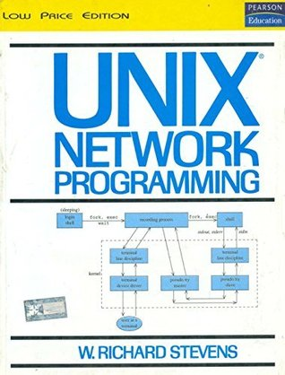
Network Programming

Slide 2
Network programming involves writing programs to communicate with processes either on the same or on other machines on the network using standard Protocols…

Slide 3
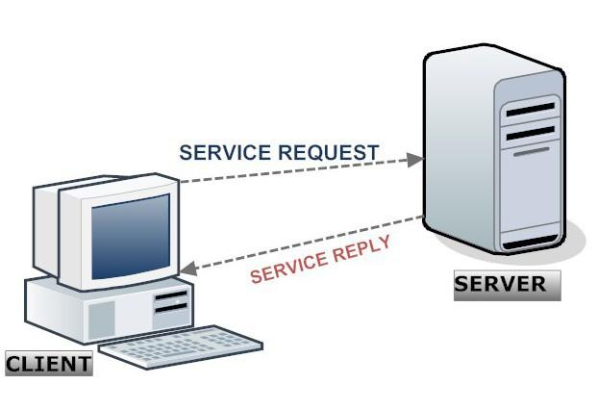
High-level decision must be made as to which program would initiate the communication first and when responses are expected…
WebServer program waits for clients to send request and only after the request is received it responds with a reply…

Slide 4
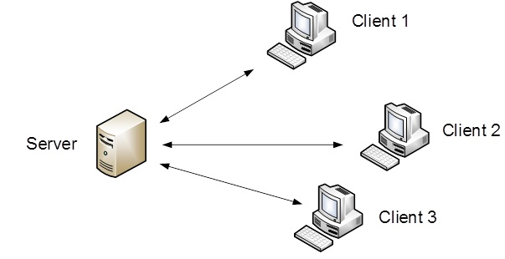
Single Server – Serving multiple Clients
https://www.youtube.com/watch?v=1z0ULvg_pW8

Slide 5
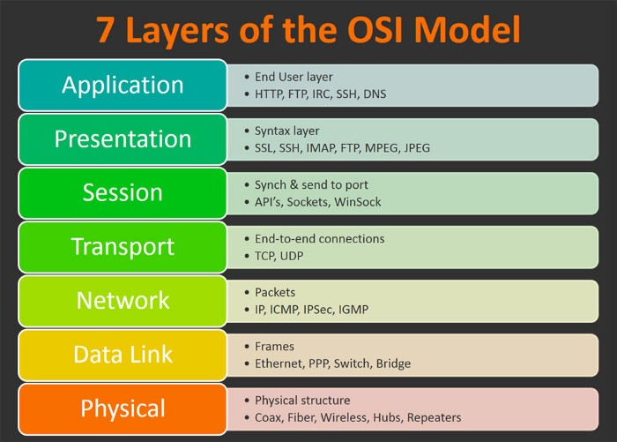
OSI - Model

Slide 6
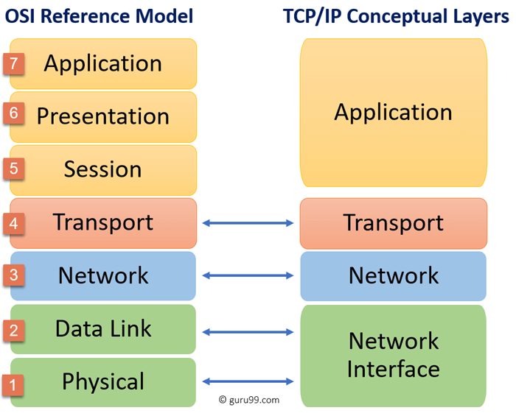
TCP/IP Model

Slide 7
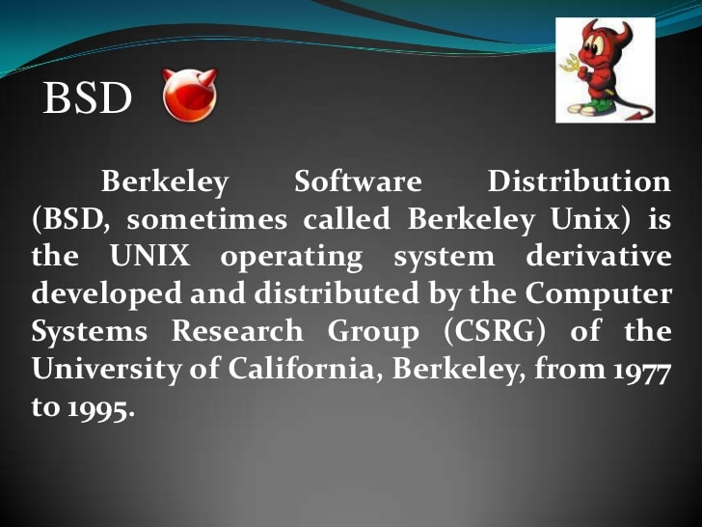
BSD

Slide 8
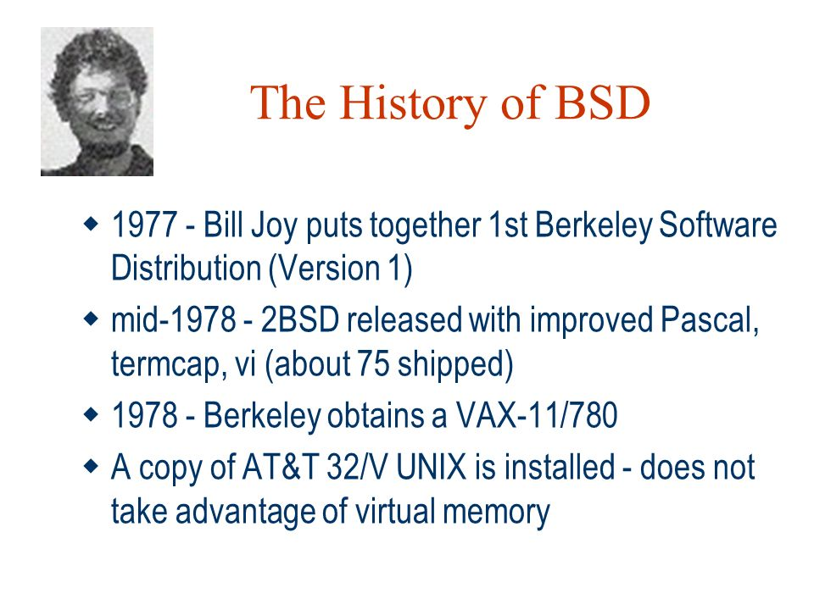
BSD

Slide 9
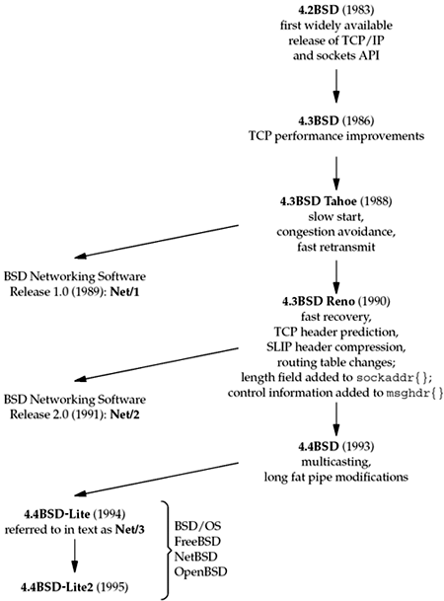
BSD History

Slide 10
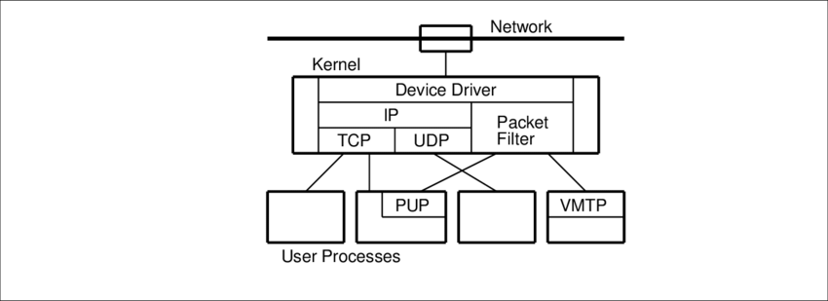

BSD Network
Potentially Unwanted Applications
Versatile Message Transaction Protocol

Slide 11
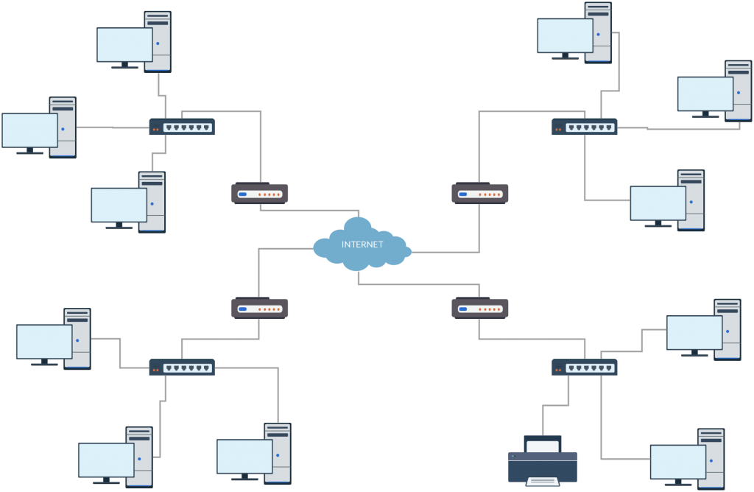
Test Network and Hosts

Slide 12
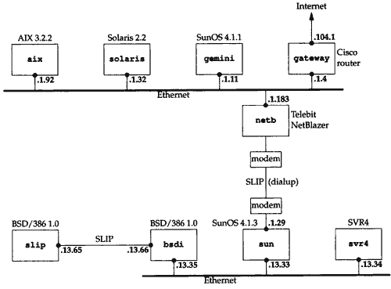
Test Network and Hosts

Slide 13
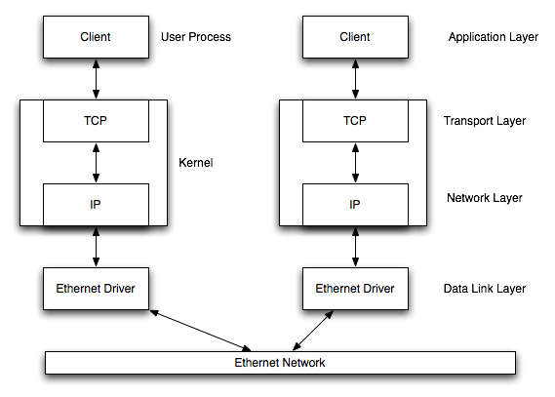
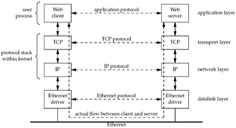
Communication over LAN

Slide 14
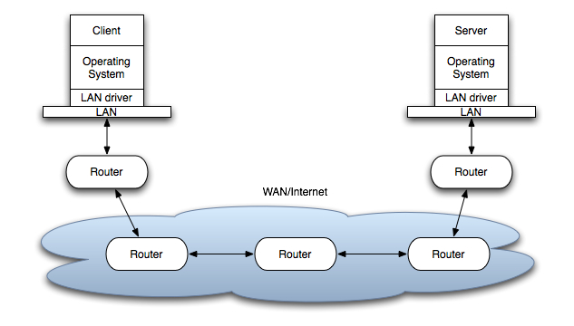
Communication over WAN

Slide 15
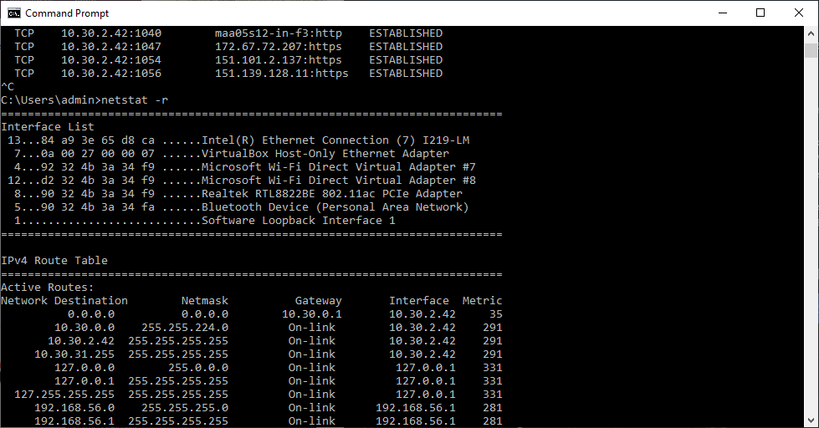
Discovering Network Topology – netstat –ni and netstat -r
Options | Meaning
-a | All ( TCP, UDP, SCTP, ICMP )
-n | Numeric addresses
-b | Display executables
-o | Process id
-f | Fully Qualified domain name
-p proto | Specific protocols
-r | Routing table
-s | Protocol statistics
-t | Current connection network status

Slide 16
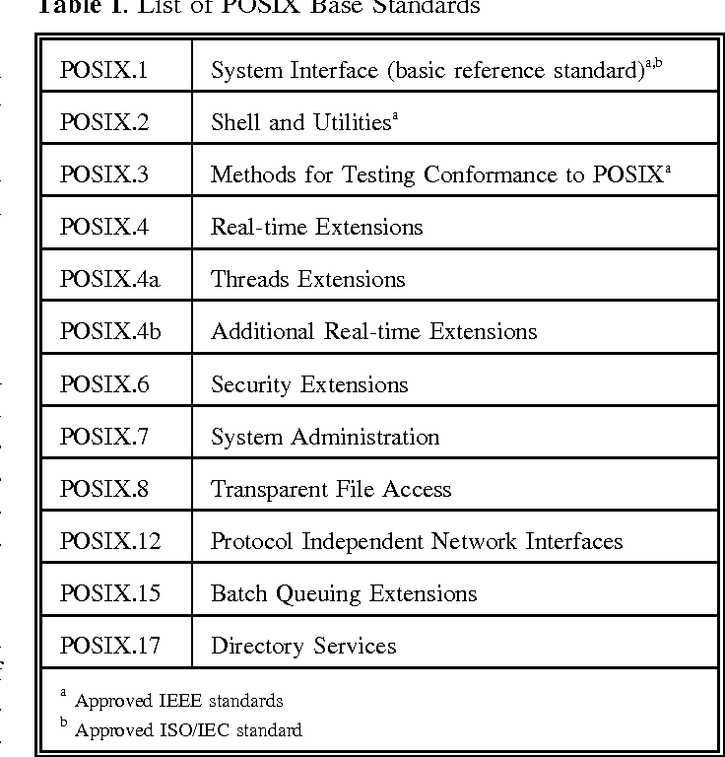
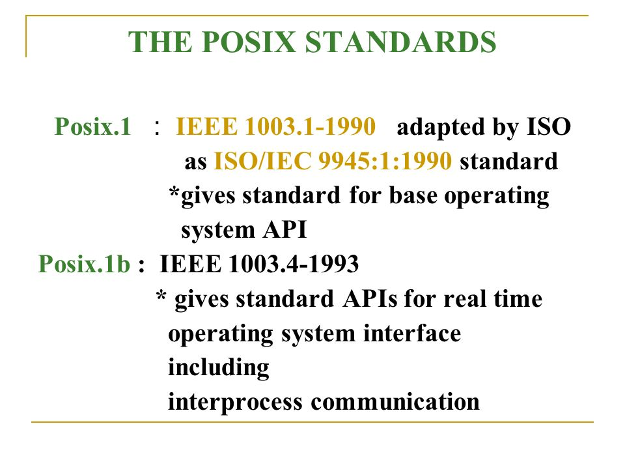
Unix Standard - POSIX
Posix.1c : Threads and Extensions

Slide 17
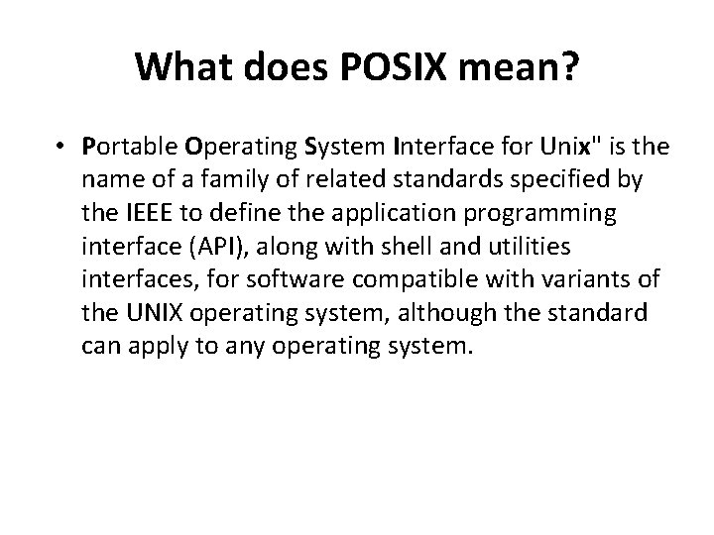
Unix Standard - POSIX

Slide 18
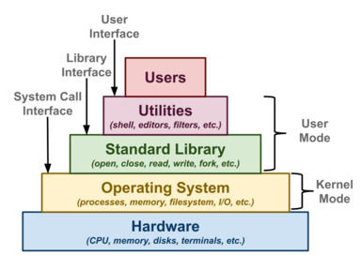
Unix APIs

Slide 19
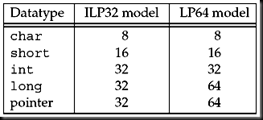
64 Bit Architectures

Slide 20
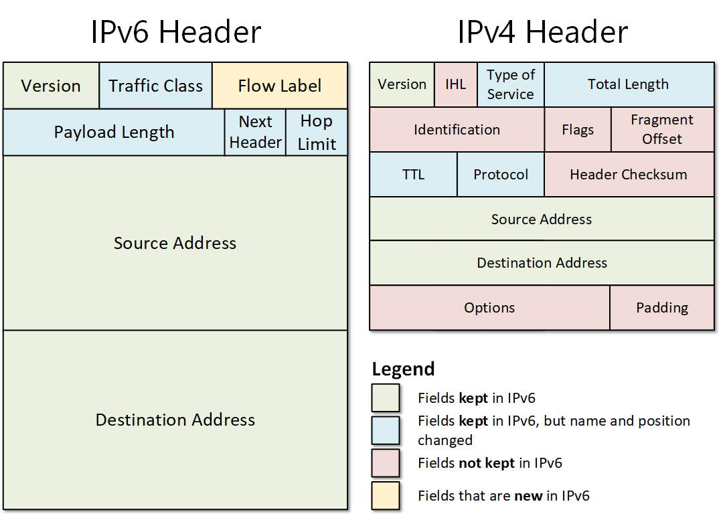
64 Bit Architectures

Slide 21
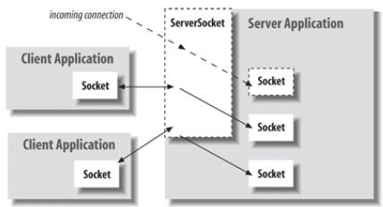
Sockets : An end point for communication between processes across the network

Slide 22
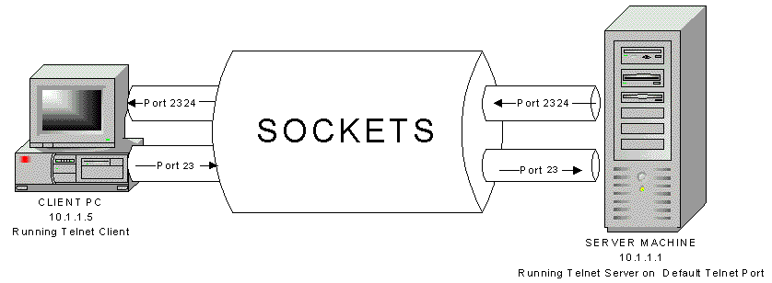
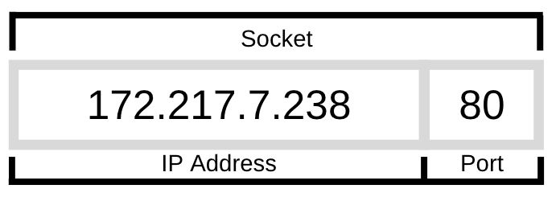
Sockets : An end point for communication between processes across the network

Slide 23
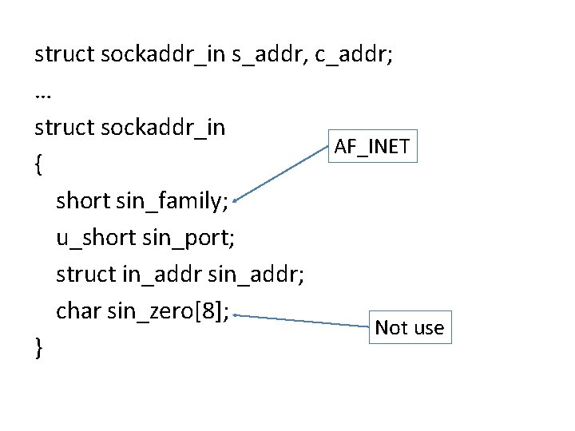
Sockets : An end point for communication between processes across the network
struct in_addr { unsigned long s_addr;
};

Slide 24
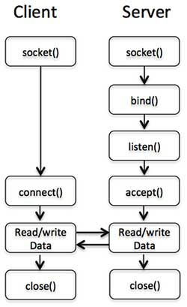
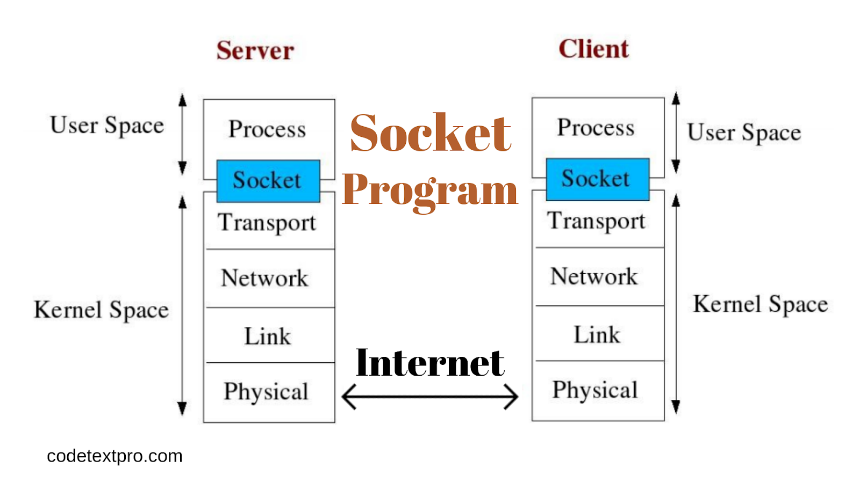
Day Time Server at port no. 13
Example ::
Day Time Client….

Slide 25
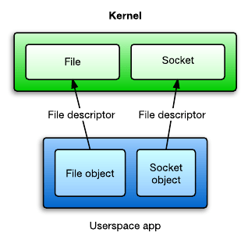
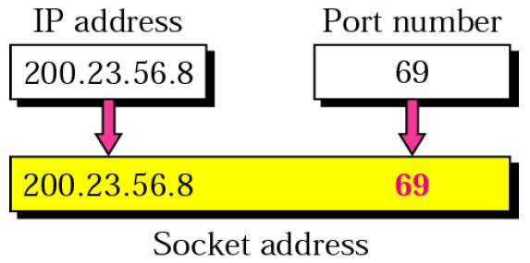
}
#include <sys/socket.h>
#include <sys/types.h>
#include <netinet/in.h>
#include <netdb.h>
#include <stdio.h>
int main(int argc, char **argv)
{
int sockfd, n = 0;
char recvline[1000 + 1];
struct sockaddr_in servaddr;
int port = 13;
if ((sockfd = socket(AF_INET, SOCK_STREAM, 0)) < 0) {
err(1, "Socket Error");
}
bzero(&servaddr, sizeof(servaddr));
servaddr.sin_family = AF_INET;
servaddr.sin_port = htons(port);
inet_pton(AF_INET,argv[1],&servAddress.sin_addr);
if (connect(sockfd, (struct sockaddr *) &servaddr, sizeof(servaddr)) < 0) {
err(1, "Connect Error");
}
Source Code of Day Time Client
AF_APPLETALK | Apple Computer Inc. Appletalk network
AF_INET | Internet domain
AF_PUP | Xerox Corporation PUP internet
AF_UNIX | Unix file system
127.0.0.1 -- > b'\x7f\x00\x00\x01'

Slide 26
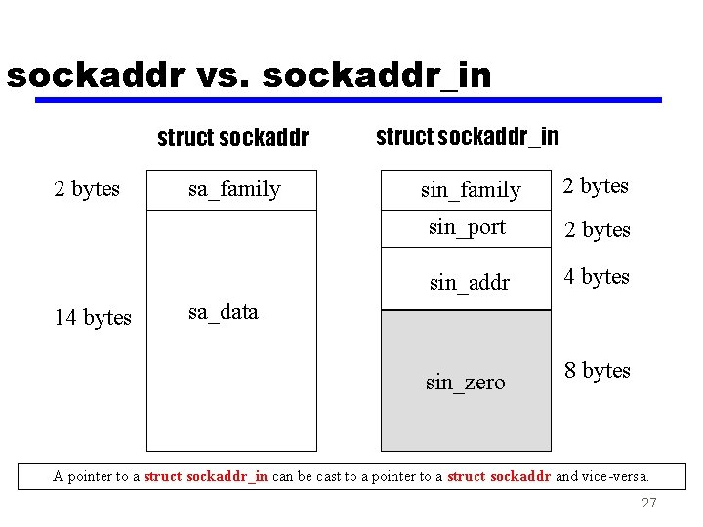
while ((n = read(sockfd, recvline, 1000)) > 0) {
recvline[n] = 0;
fputs(recvline, stdout);
}
return 0;
}

Slide 27
while ((n = read(sockfd, recvline, 1000)) > 0) {
recvline[n] = 0;
fputs(recvline, stdout);
}
return 0;
}
struct in_addr {
unsigned long s_addr;
};

Slide 28
DayTime Server…
#include <sys/socket.h>
#include <sys/types.h>
#include <netinet/in.h>
#include <netdb.h>
#include <stdio.h>
int main(int argc, char **argv)
{
int listenfd, connfd;
int port = atoi(argv[1]);

Slide 29
struct sockaddr_in servaddr;
char buff[1000];
time_t ticks;
listenfd = socket(AF_INET, SOCK_STREAM, 0);
bzero(&servaddr, sizeof(servaddr));
servaddr.sin_family = AF_INET;
servaddr.sin_addr.s_addr = htonl(INADDR_ANY);
servaddr.sin_port = htons(port);
CREATE A SOCKET
Initialize Socket Address

Slide 30
bind(listenfd, (struct sockaddr *) &servaddr, sizeof(servaddr));
listen(listenfd, 8);
for (;;) {
connfd = accept(listenfd, (struct sockaddr *) NULL, NULL);
ticks = time(NULL);
snprintf(buff, sizeof(buff), "%.24s\r\n", ctime(&ticks));
write(connfd, buff, strlen(buff));
close(connfd);
}
}
Bind the SOCKET
Listen on the Port for connections
Accept connection request from Client
Write to socket… { Serve the Client }

Slide 31
}
int main()
{
int s;
struct sockaddr_in6 addr;
s = socket(AF_INET6, SOCK_STREAM, 0);
addr.sin6_family = AF_INET6;
addr.sin6_port = htons(5000);
inet_pton(AF_INET6, "::1", &addr.sin6_addr);
connect(s, (struct sockaddr *)&addr, sizeof(addr));
while ((n = read(sockfd, recvline, 1000)) > 0) { recvline[n] = 0; fputs(recvline, stdout); }
close(sockfd);
return 0;
}
Source Code of Day Time Client – IPV6

Slide 32
}
Error Handling and Wrapper functions
In any real-world program, it is essential to check every function call for an error return we check for errors from socket, inet_pton, connect, read, and fputs, and when one occurs, we call our own functions, err_quit and err_sys, to print an error message and terminate the program.
We find that most of the time, this is what we want to do. Occasionally, we want to do something other than terminate when one of these functions returns an error
int Socket(int family, int type, int protocol)
{ int n;
if ( (n = socket(family, type, protocol)) < 0)
err_sys("socket error");
return (n);
}

Slide 33
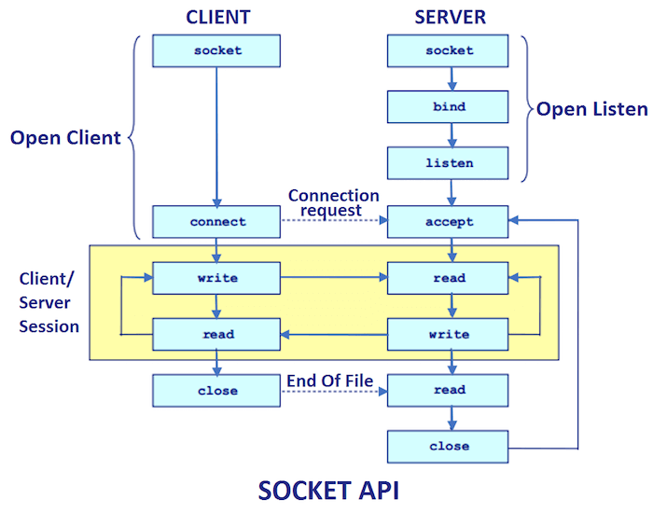

Slide 34
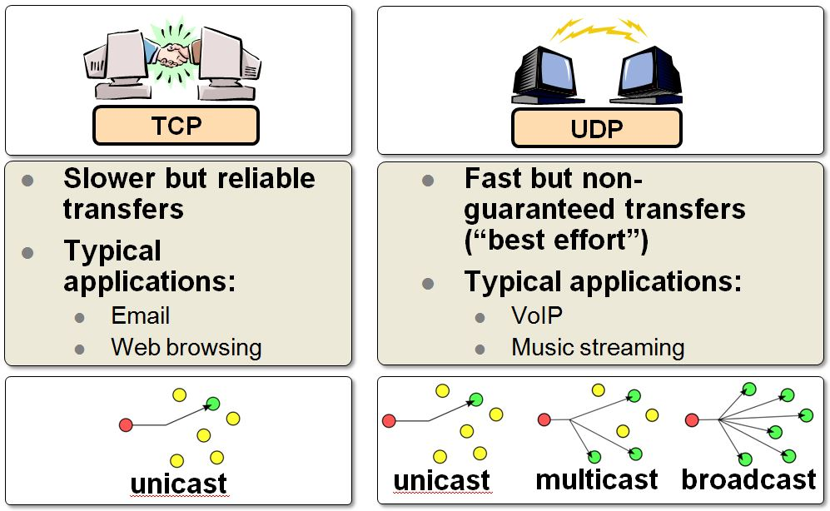
}
TCP AND UDP

Slide 35
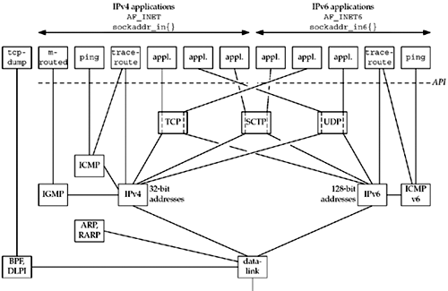
}
TCP/IP – The Big-picture

Slide 36
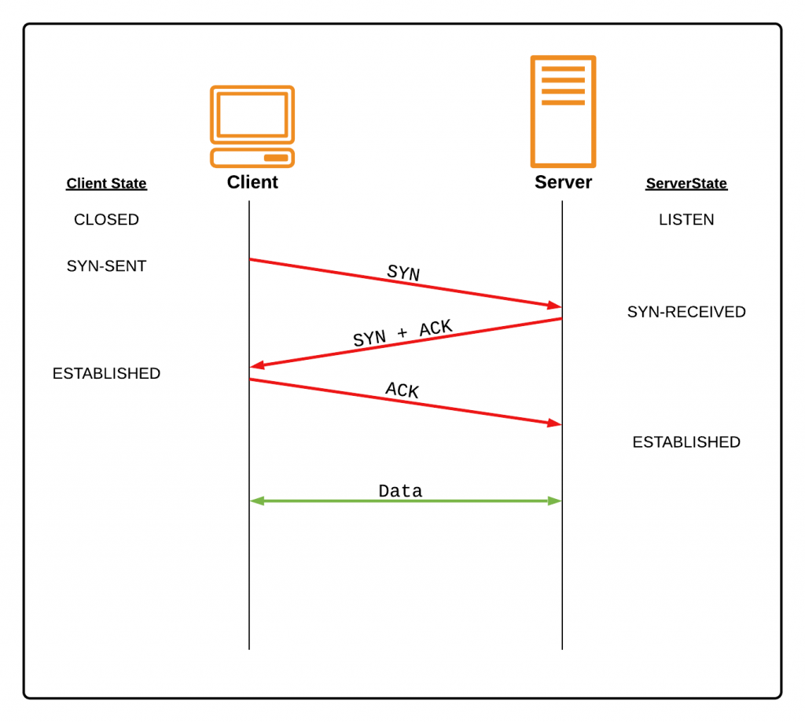
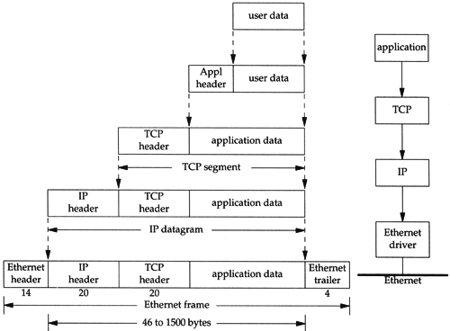
}
TCP - Connection

Slide 37
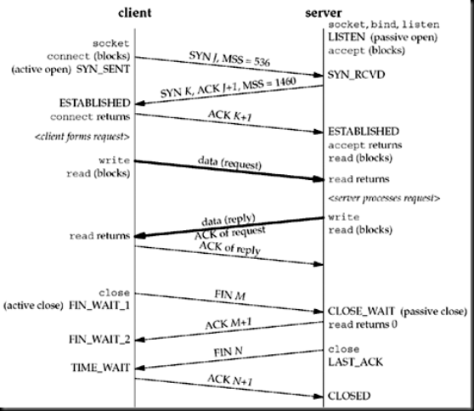
TCP – Connection : Packet Exchange

Slide 38
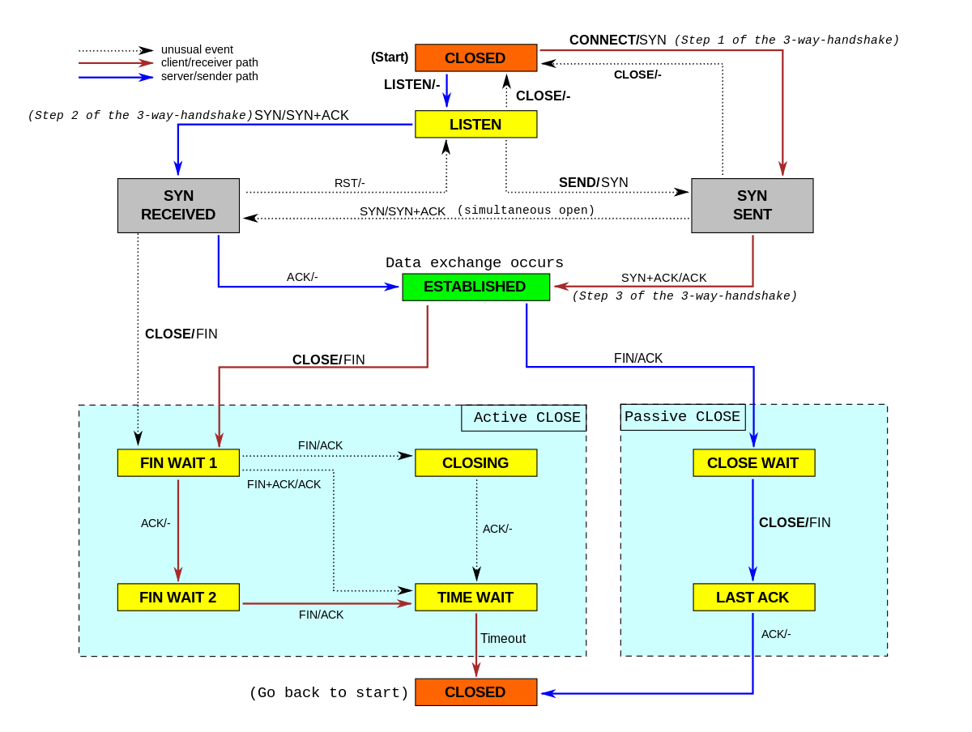
TCP-Connection state diagram

Slide 39
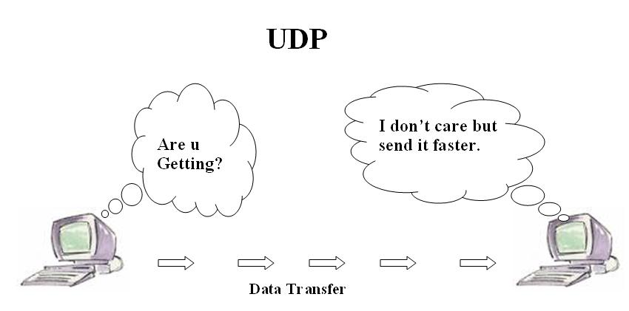
}
UDP

Slide 40
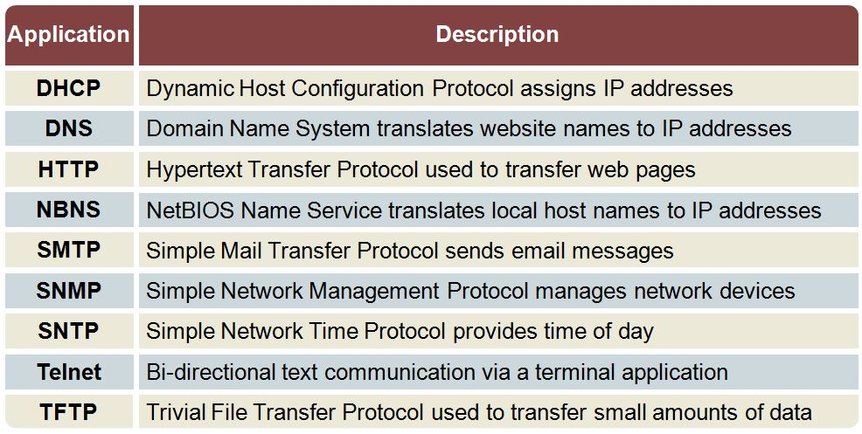
}
TCP Use cases

Slide 41
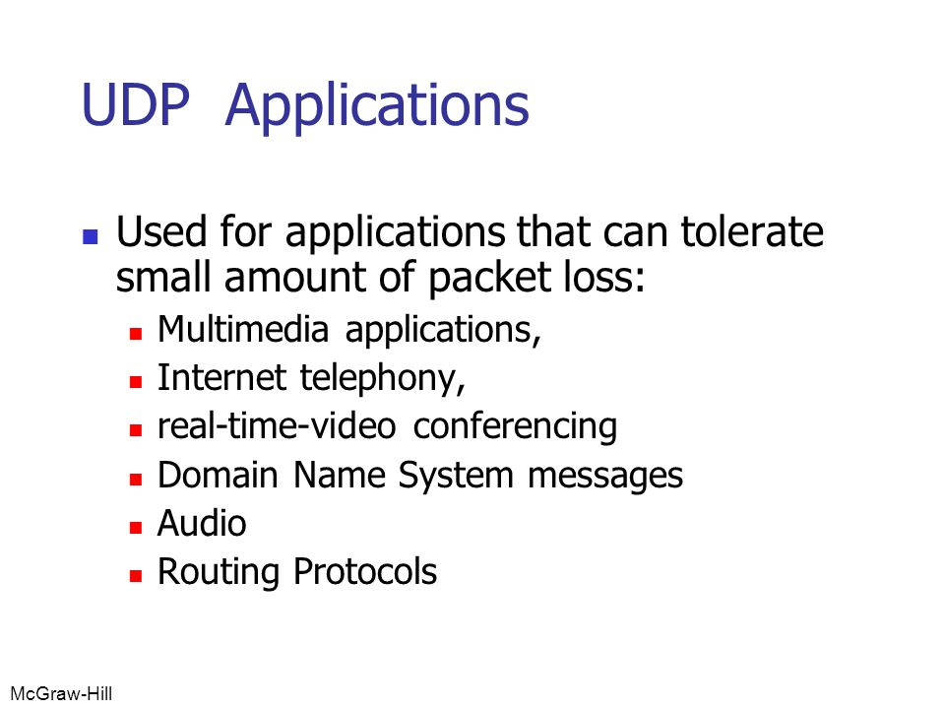
}
UDP Use cases

Slide 42
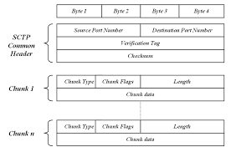
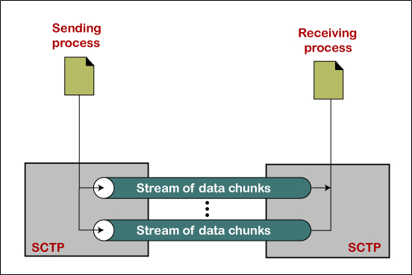
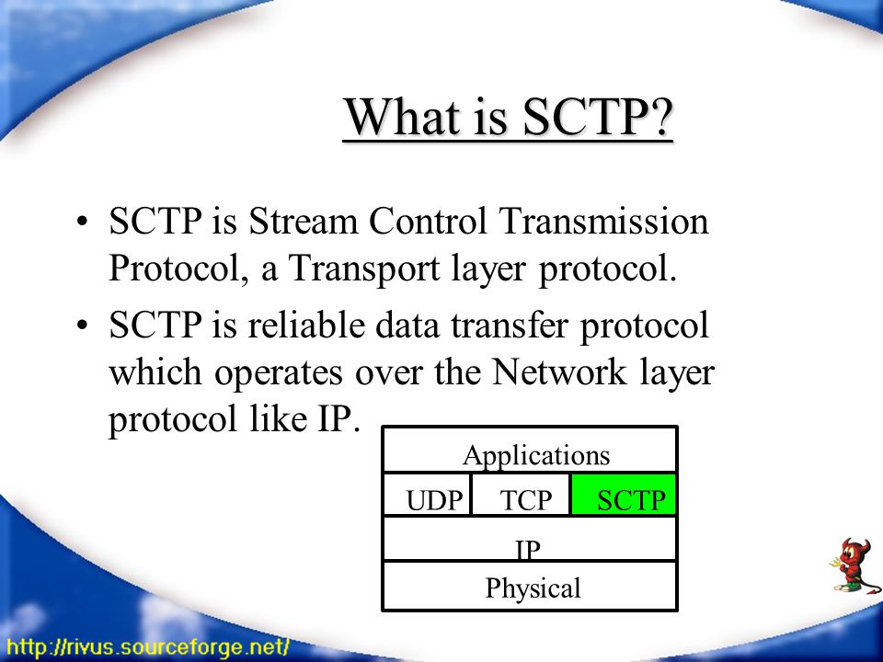
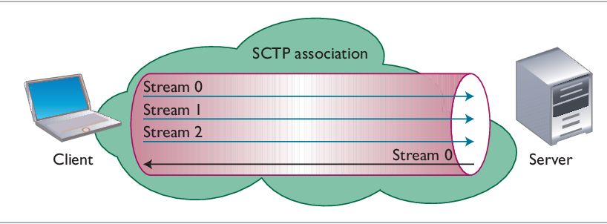
SCTP

Slide 43
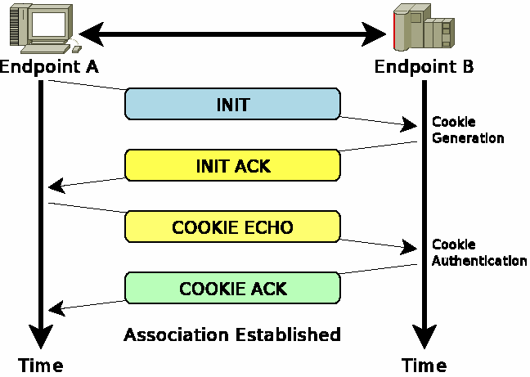
}
SCTP – 4 way Handshake

Slide 44
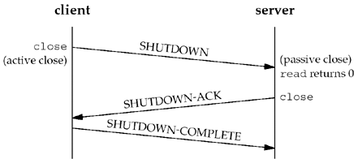
}
SCTP – Closing

Slide 45
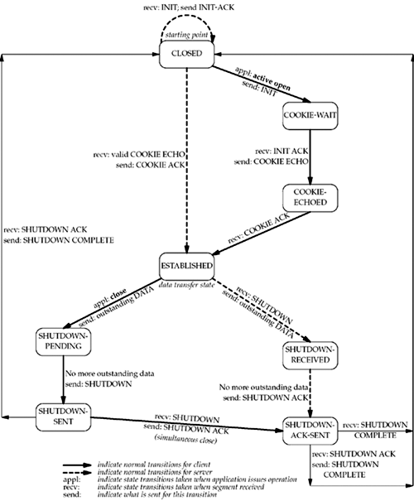
}
SCTP – State Transition Diagram

Slide 46
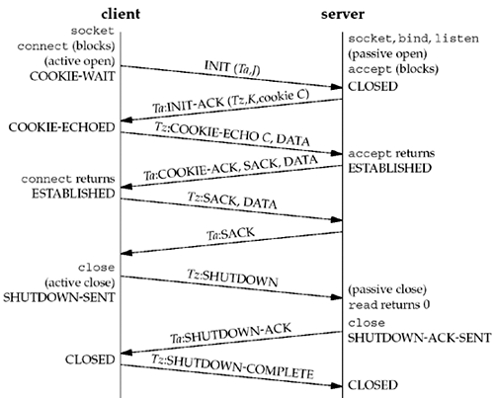
}
SCTP – Packet Exchange

Slide 47
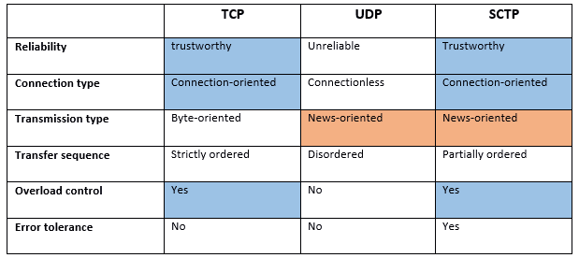
Comparison

Slide 48
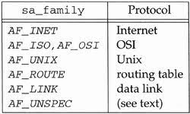
}
Socket Address Families

Slide 49

Socket Address Structure – IPV4

Slide 50
Socket Address Structure – IPV4

Slide 51

Socket Address Structure – Generic Address

Slide 52

Network and Host Byte Ordering
Network Byte Order – Big-Endian

Slide 53


Byte Order conversion functions

Slide 54
Byte Order conversion functions

Slide 55

Byte Order conversion functions

Slide 56

Value Result Arguments

Slide 57

Value Result Arguments

Slide 58

IPV4 and IPV6
SCTP

Slide 59
APIs – For concurrent Server
Socket
Bind
Listen
Accept
fork and exec

Slide 60

APIs – For concurrent Server
fork and exec

Slide 61

APIs – For concurrent Server
fork and exec

Slide 62

APIs – getsockname and getpeername

